Slide 1


Group A Presentation - Election Bridge: Civic Intelligence & Engagement
ALY 6080 – Integrated Experiential Learning
College of Professional Studies
Northeastern University
Vancouver, B.C.
Herath Gedara, Chinthaka Pathum Dinesh, PhD
Instructor
Fall 2023
Group Members:
Nana Osei Fordwouh
Papa Ekow Armah
Wai Phyo Maung
Supreet Mann
Shreyansh Bhalodiya
Manjyot Kaur Gill

Slide 2

Introduction
Dataset Overview
Comprehensive information on city council orders, sponsor-related data, temporal insights, and demographic details of the City of Portland, Maine.
Number of columns: 11
Number of Rows: 390
All variables were strings
Business Questions
Mission: How does Election Bridge aim to bridge the communication gap between citizens and government?
Products & Services: What unique offerings does Election Bridge provide to its users?
Competitive Landscape: Who are the main competitors, and how does Election Bridge differentiate itself?
Evolving Industry Trends: What are the key trends shaping the civic engagement sector?
CEO's Focus Areas: If leading Election Bridge, what would be the primary areas of attention to ensure success?

Slide 3
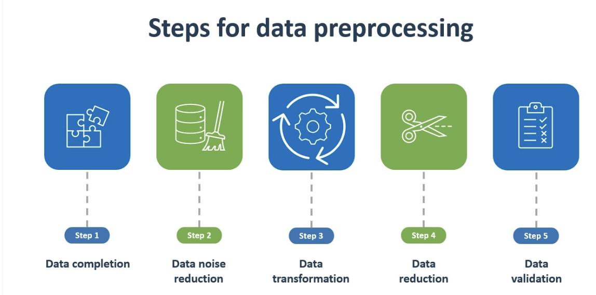
Data Preparation and Preprocessing
Leveraging libraries such as pandas, spaCy, PyPDF2, and re, we extracted information from PDF files into a 'PDF Content' column.
This data was then used to categorize policies and organize addresses into neighborhoods, which are now displayed in a new 'Address' column.
We eliminated non-essential columns including 'Classification Number', 'Type', 'Passage Date', 'Effective Date', and 'Category Types’.
After ensuring all missing or null values were resolved, our dataset is now thoroughly prepared for further use.

Slide 4
Exploratory Data Analysis 1
Distribution of Categories for Orders Approved
The 'Issue Category' field shows a diverse categorization of entries.
'Education' is the most prevalent category with 114 entries, followed by 'Uncategorized' at 84, indicating a large set of items not assigned to specific categories.
Various combinations of 'Education', 'Infrastructure', and 'Safety' account for a substantial number, with 57, 40, and 34 entries respectively.
The 'Safety' category alone has 14 entries, while 'Infrastructure' appears both alone (11 entries) and in combination with other categories.
'Environment' related categories vary in frequency, ranging from 5 to 8 entries, often combined with 'Education' and 'Infrastructure’.
'Zoning' categories are less frequent, with 'Zoning' and 'Zoning and infrastructure' totaling 5 entries.
This distribution highlights a focus on education-related issues, with significant emphasis also on infrastructure, safety, and environmental concerns in various combinations.

Slide 5
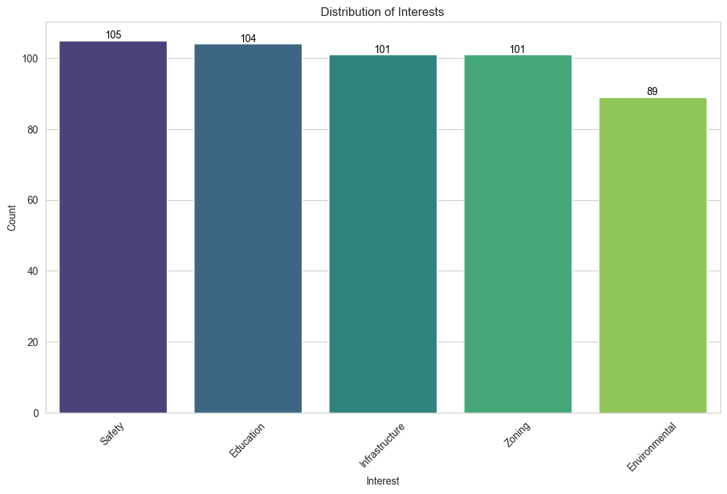
Exploratory Data Analysis 2
Distribution of Users’ Interests
The user data shows a fairly even distribution across various categories, with 'Safety' slightly leading at 105 entries, closely followed by 'Education' and 'Infrastructure', each with 104 and 101 entries respectively.
'Zoning' also has 101 entries, indicating a similar level of focus as 'Infrastructure’.
'Environment' has a slightly lower representation at 89 entries.
This balanced distribution suggests a broad interest or focus across these key areas - safety, education, infrastructure, zoning, and environmental concerns.

Slide 6
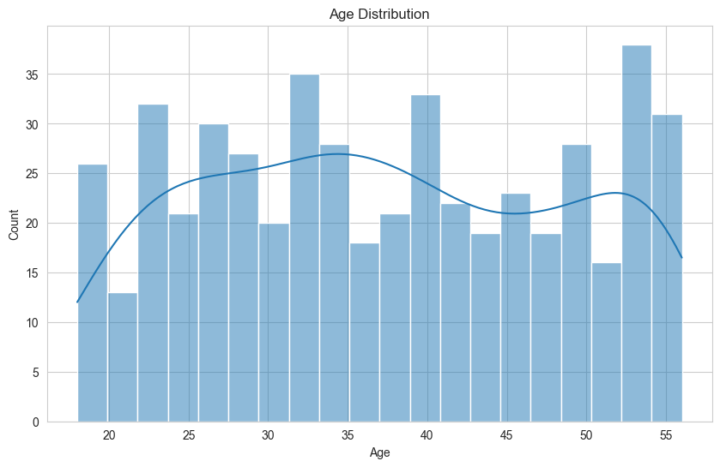
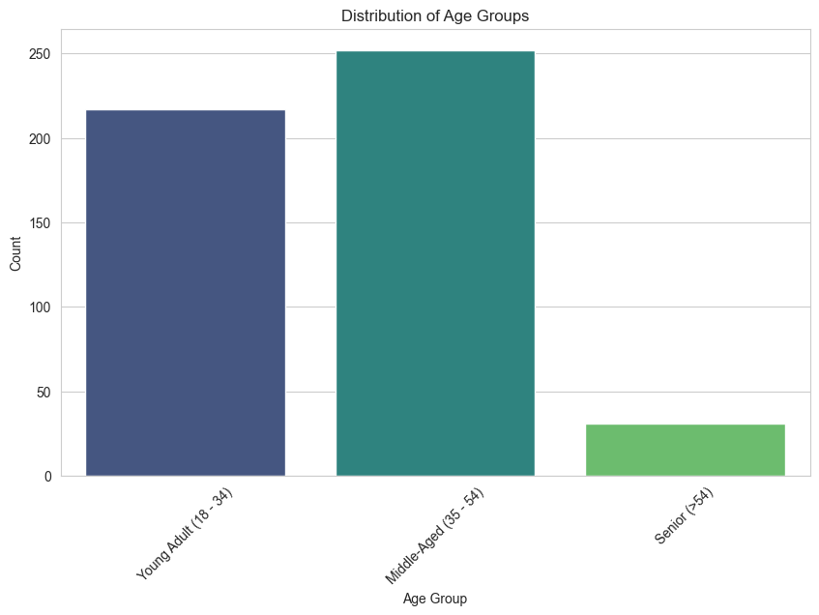
Exploratory Data Analysis 3
(Left) Age Distribution and (Right) Distribution of Age Groups
Most of the users are aged between 18 and 54 representing young adults and middle aged.

Slide 7
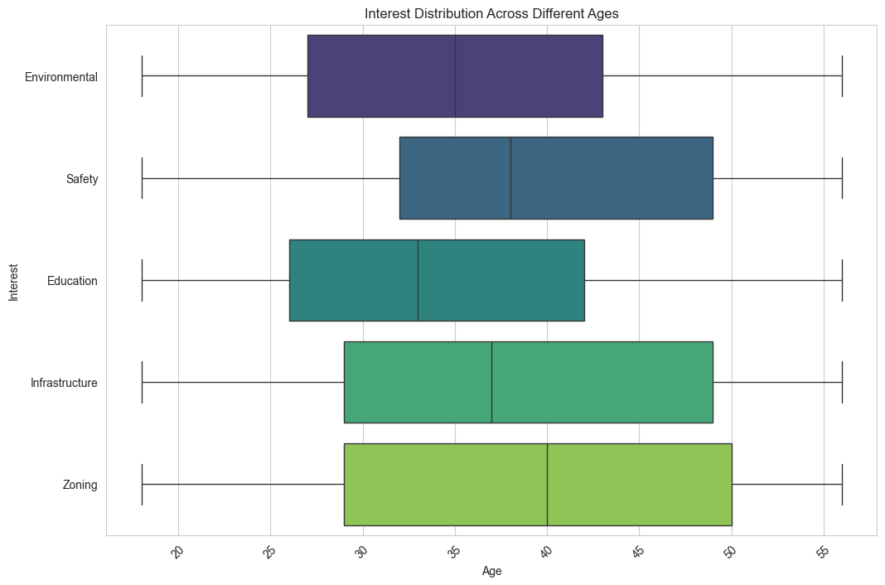
Exploratory Data Analysis 4
Whereas younger users are interested in Education and Environmental policies, older people are much more interested in Infrastructure, Zoning and Safety.
Interest Distribution Among Ages

Slide 8
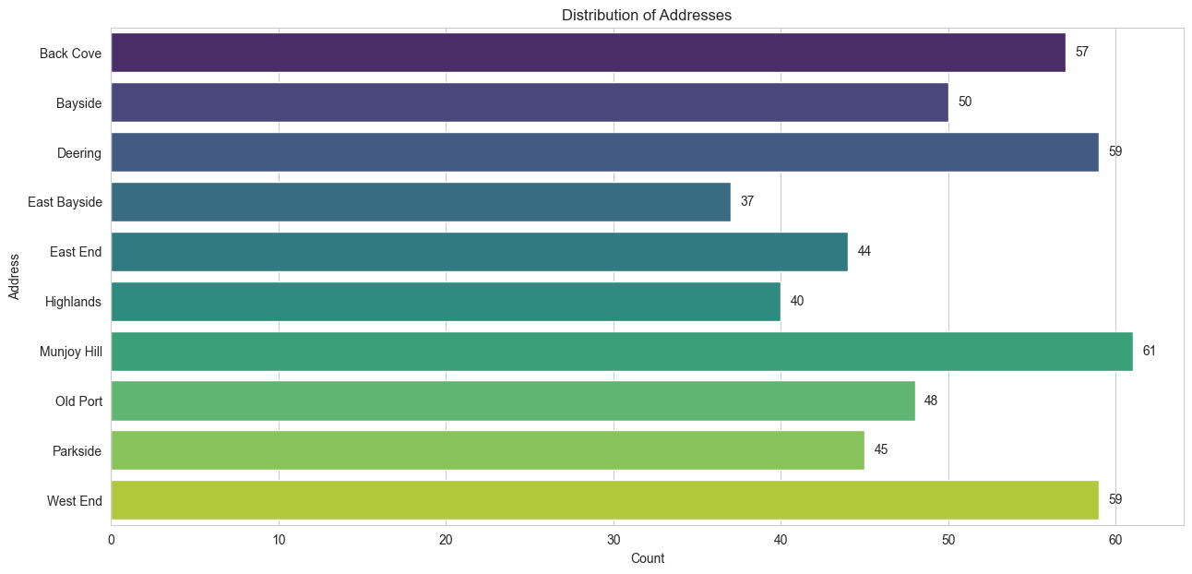
Exploratory Data Analysis 5
Distribution of Addresses
Most users live in Munjoy Hill, West End, Deering, Back Cove and Bayside.
East Bayside and Highlands recorded the least number of users.

Slide 9
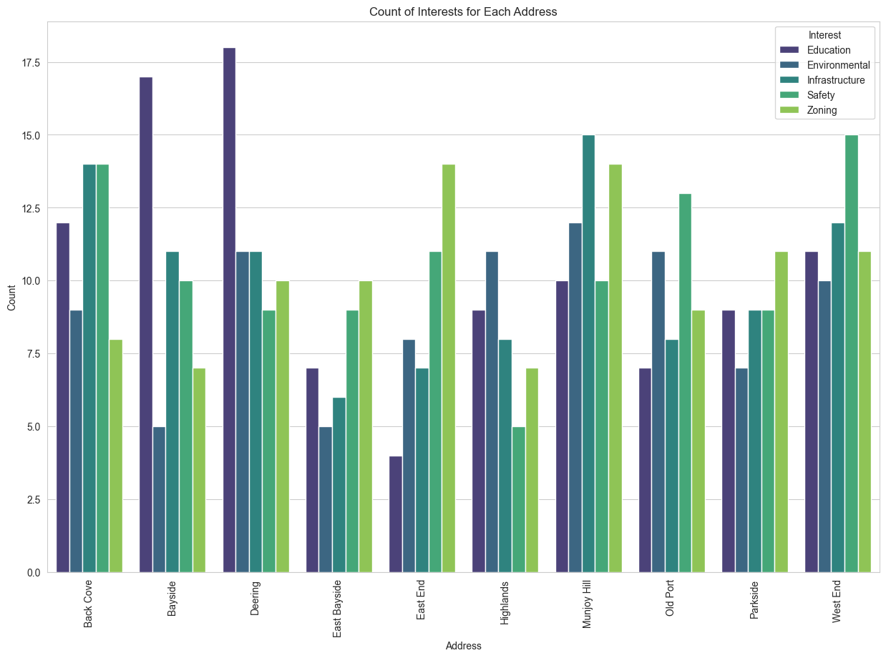
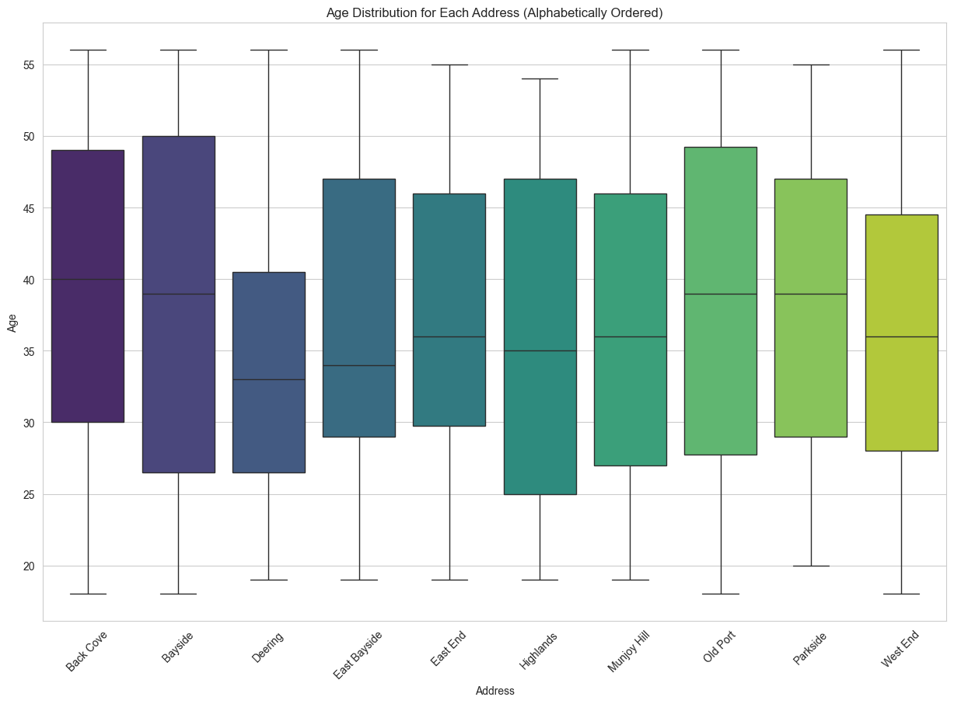
Exploratory Data Analysis 6
(Left) Interest Distribution For each address and (Right) Age Distribution for each address
Bayside and Deering users are more interested in Education whereas Munjoy Hill and Back Cove users are interested in Infrastructure.
East Bayside, East End and Parkside users are interested in Zoning while West End and Old Port users are more interested in Safety.
More younger people live in Highland as compared to Bayside which has older users.

Slide 10
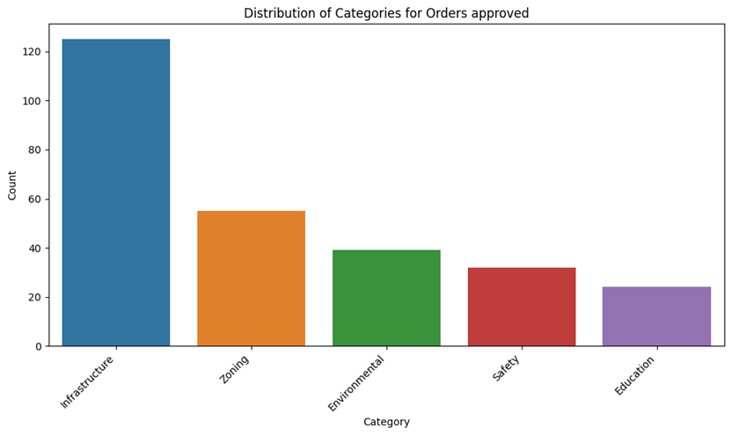
Methodology 1: Manual Labelling
As part of our analysis, we firstly labelled all the provided orders manually. This was done to help us check accuracies of any models being trained in future.
The image on the left shows the count of approved orders category wise.
It is clearly visible that mostly orders have been passed for the infrastructure with least number of orders in education sector.

Slide 11
Methodology 1: Labelling with Algorithms
The approach involved steps in processing the content from PDF documents.
Four unsupervised learning algorithms, which utilized keyword-matching techniques, were employed to categorize the policies based on their content. This method allowed for the automated sorting of policies into distinct categories by identifying and matching key terms within the text.
First approach:
Keyword matching with word vector
Results; 200 uncategorised policies
Second approach:
Keyword matching with BERT model
Results = 352 uncategorized policies

Slide 12
Methodology 1: Labelling with Algorithms
Third approach:
Keyword matching with Lbl2Vec
Results = 167 uncategorized policies
Lbl2Vec is an embedding-based approach for document retrieval on predefined topics.
Fourth approach:
Keyword matching with WordNet
Results = 89 uncategorized policies

Slide 13
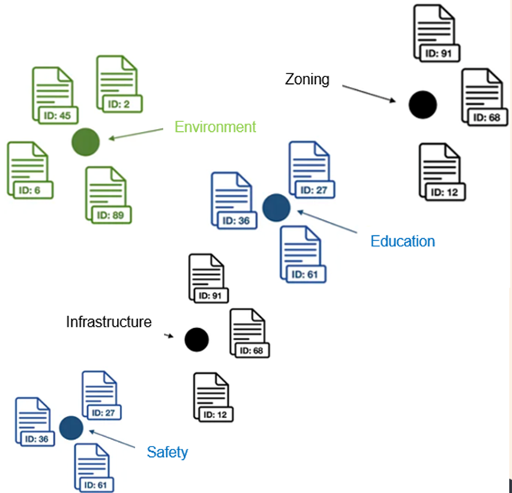
Methodology 1: How Lbl2Vec worked?
Use Manually Defined Keywords for Each Category of Interest
Create Jointly Embedded Document and Word Vectors
Find Document Vectors that are Similar to the Keyword Vectors of Each Classification Category
Clean Outlier Documents for Each Classification Category
Compute the Centroid of the Outlier Cleaned Document Vectors as Label Vector for Each Classification Category as shown in this image.
Text Document Classification
Assign vectors, computed as the central points of the corresponding refined candidate document vectors. The dots symbolize the label vectors associated with the respective topics.

Slide 14
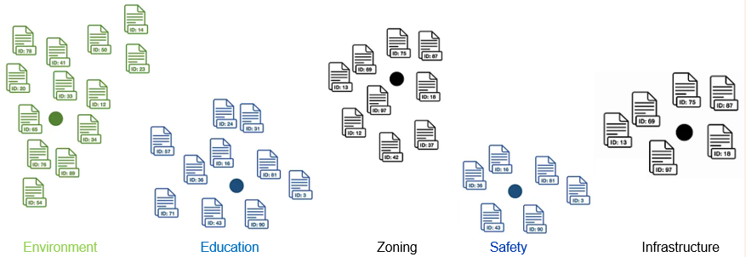
Results of Lbl2Vec Algorithm
Each order had a manually labelled category which was an added advantage to check the categories quickly.
We used that to check if we got the category types were correct or wrong for all the orders.
Out of all ~400 orders, our model categorized 57% of categories correctly.
The results of classifying all documents in the dataset are depicted. Each point on the graph corresponds to the label vectors of a specific classification category.

Slide 15
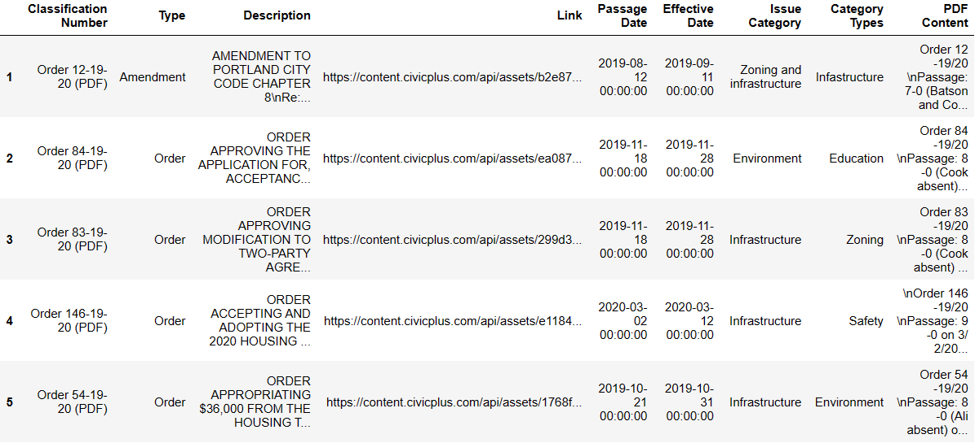
Policy Categorization with Word Net
Upon review, Word Net (77%) outperformed Lbl2Vec (57%) in accuracy and precision, categorizing more policies correctly and leaving fewer outliers.
While Lbl2Vec has the advantage of quick category checks due to manual labels, the higher precision of Word Net suggests it is a more effective tool for our needs.
Decision to adopt Word Net for policy categorization.

Slide 16
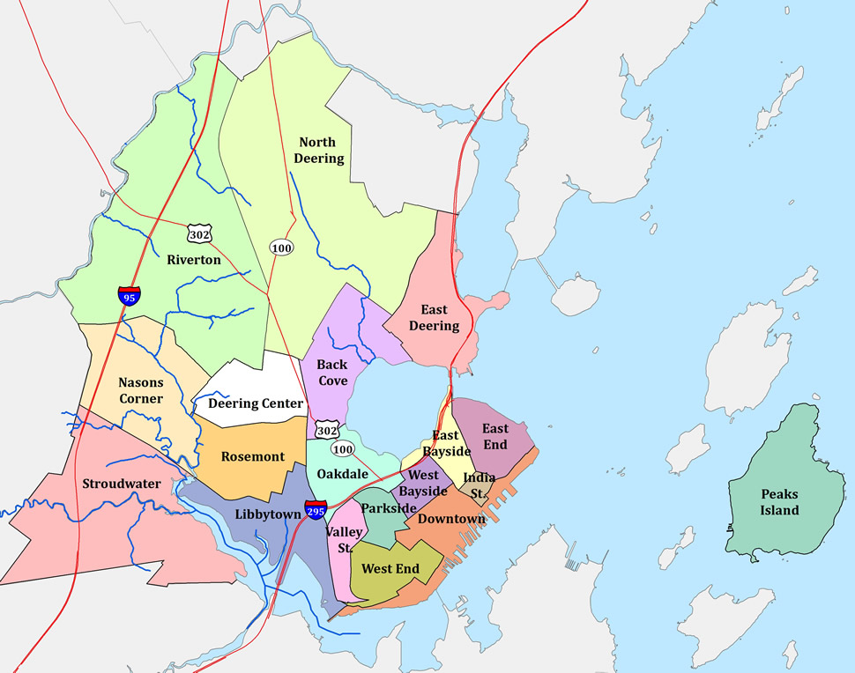
Methodology 2
Second, for the geographical categorization of these policies, the Google API was used. This step involved extracting street addresses from the PDFs and then classifying them into various neighborhoods within the City of Portland.
This geographical classification helped in understanding the spatial distribution of the policies. For those policies where specific street addresses were not available or explicitly mentioned, they were broadly classified under the 'City of Portland’.
This classification scheme ensured that all policies were categorized, maintaining a comprehensive overview, both in terms of policy type and geographical relevance to different parts of Portland.

Slide 17
Modeling, Results and Findings
The model aims to predict the policy category based on two key predictor variables: the 'Issue Category' and the 'Address'. In this context, the 'Policy Category' is the target variable.
The relationship can be succinctly described by the formula:
P=F(I,A)
Here, F represents the mathematical function that combines the Issue Category (I) and Geographical Address (A) to predict the Policy Description Category (P). This equation captures the essence of our predictive framework, highlighting the synergy between the issue's nature and its geographical context in determining policy outcomes.

Slide 18
Modeling, Results and Findings
Three machine learning algorithms were utilized: Naive Bayes, SVM (Support Vector Machine), and Random Forest Classifier.
Approach:
Trained the dataset with a split of 80-20, dividing it into training and testing sets.
Results:
Key Findings:
The performance of both Naive Bayes and SVM is very low, with accuracy just above 1%, and extremely low precision and F1 scores.
Random Forest shows no predictive accuracy, with all metrics at zero, indicating a total failure in this scenario.
These results suggest significant issues with model fit, data quality, or feature selection, necessitating a review of the data preprocessing and model tuning.
 | Accuracy | Precision | Recall | F1 Score
Naive Bayes | 0.012821 | 0.000217 | 0.012821 | 0.000427
SVM | 0.012821 | 0.000229 | 0.012821 | 0.000450
Random Forest | 0.000000 | 0.000000 | 0.000000 | 0.000000

Slide 19
Modeling, Results and Findings
In response to the poor performance of our initial three models, we decided to switch to a different method, selecting K-means Clustering as our revised approach.
Approach: We applied one-hot encoding to 'Address' and 'Issue Category' and used TF-IDF vectorization for 'Description', merging them into a single dataset. We then set the number of clusters (k) to 5 in the K-Means algorithm, aligning with our aim of analyzing five distinct categories.
Results:
Key Findings:
The results from this clustering approach revealed that the data was effectively segmented into five separate clusters.
This clustering reflects our analysis categories and showcases the utility of the K-means algorithm in organizing the data into clearly defined groups.
0 | 114
1 | 84
2 | 40
3 | 95
4 | 57

Slide 20
Summary and Conclusion
The models initially deployed—Naive Bayes and SVM—demonstrated very low effectiveness, with an accuracy slightly above 1%, and negligible precision and F1 scores. The Random Forest model failed, registering zeros across all performance metrics. These outcomes strongly indicate issues with model suitability, data integrity, or feature engineering, prompting a need to revisit data preprocessing and model optimization.
Shifting to unsupervised learning, the K-means clustering technique was applied, successfully dividing the data into five distinct clusters. This division aligns well with the five predefined analysis categories and underscores K-means clustering's ability to organize data into well-delineated groups.
This method's effectiveness highlights its potential as a more appropriate approach for this dataset, especially due to the previous models' underperformance.

Slide 21
Recommendations
Based on the analysis and outcomes, the following recommendations are made to improve the model performance and data categorization:
Data Quality: Assess and enhance the quality of the dataset. Ensure that the data is complete, accurate, and relevant. Special attention should be given to address fields to ensure they contain sufficient detail for effective categorization.
Address Information: Address the issue of insufficient address information. Consider additional data enrichment strategies, such as data augmentation from external sources, to fill in the gaps where street address information is missing or incomplete.
Policy Categorization: Clarify and standardize policy categorization criteria. Develop a more robust categorization framework that can reduce ambiguity and improve the interpretability of machine learning outputs.
Feature Engineering: Re-evaluate the feature selection and engineering process. Identify more discriminative features that could better capture the nuances of policy differences and lead to improved clustering or classification results.
Model Reassessment: Reassess the choice of models and consider alternatives that may be more suitable for the dataset characteristics, especially considering the high dimensionality and sparse nature of text data.
By implementing these recommendations, there should be an improvement in the performance of the machine learning models and the overall clarity of policy categorization.

Slide 22
Future Research Direction
Predictive Modeling Refinement
Invest in refining predictive models to improve the accuracy of category predictions, aiming for a higher percentage of correct predictions.
User Engagement Patterns
Research user engagement patterns to understand how citizens interact with the platform, informing strategies to enhance user experience.
Impact Assessment Framework
Develop a framework for assessing the impact of Election Bridge on civic engagement, measuring the platform's effectiveness in facilitating communication and influencing decision-making.

Slide 23
References
Northeastern University. (n.d.). Meet Election Bridge. Retrieved from The Roux Institute: https://roux.northeastern.edu/news-articles/founder-feature-election-bridge/
Text mining: Definition, techniques, use cases. (2023, May 12). Retrieved from DataScientest: https://datascientest.com/en/text-mining-all-you-need-to-know.

Slide 24


